Slide 1
Milestone 3 ECS 165A

Slide 2
HIJK
Hanxing Zhang Isabella Pitco Jennifer Ly Kauana dos Santos

Slide 3
Posts Feature
Creating and retrieving posts on the user’s profile timeline.

Slide 4
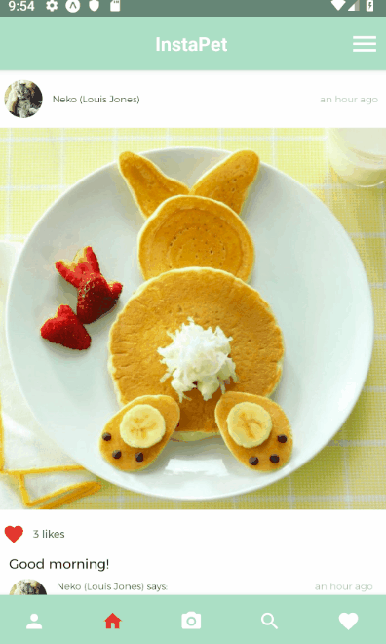
Share Photos Instantly
Choose one from your photo library or capture directly from your camera in app.

Slide 5
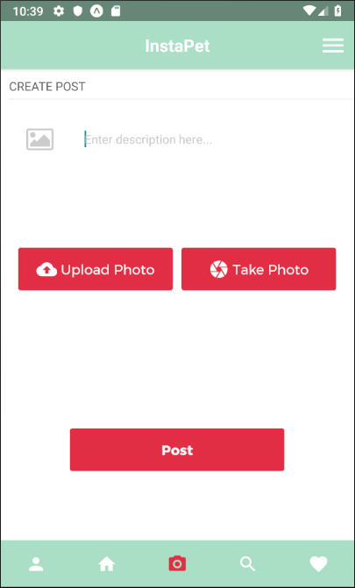
What’s stored in Firestore
Collection: Posts
Image URL
Description
User ID
Timestamp
Comments
Like count
Follower IDs

Slide 6
What’s stored in Firestore
Collection: Posts
New post is generated and write to fire store
App user can create a post by uploading a photo or taking a picture
Comments and likes are write to fire store. Likes are updated in fire store.
Followers can comment and like on a post.
All data saved in fire store and cloud storage
If edit, updates are made in fire store. If delete, the post document is removed from fire store
App user can edit or delete their own posts

Slide 7
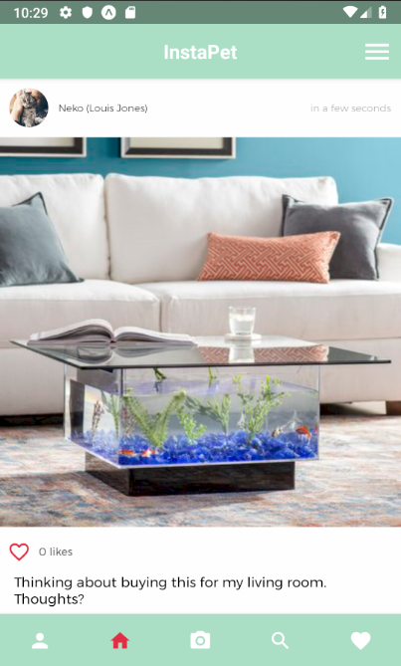
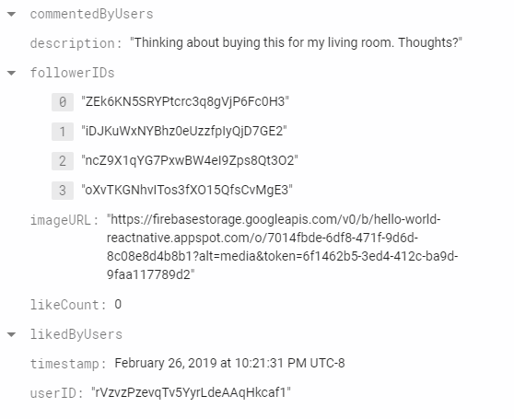
What’s stored in Firestore
Collection: Posts
Document created in posts collection

Slide 8
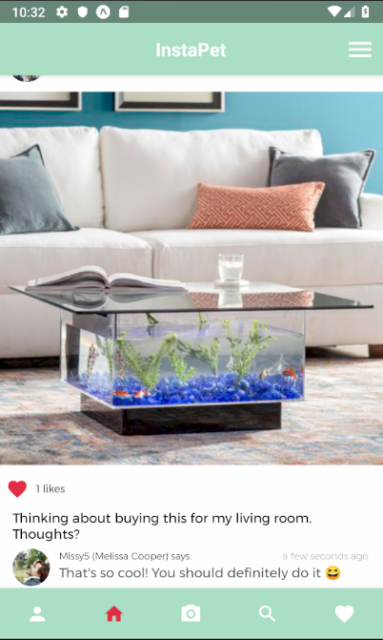
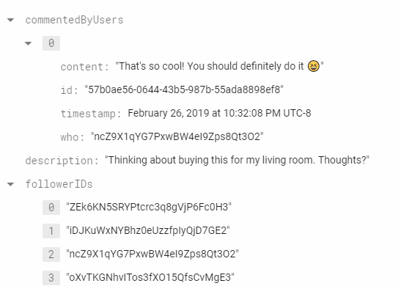
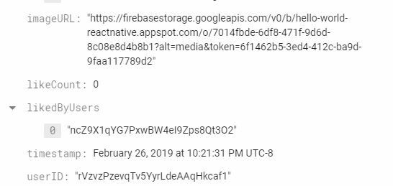
What’s stored in Firestore
Collection: Posts

Slide 9
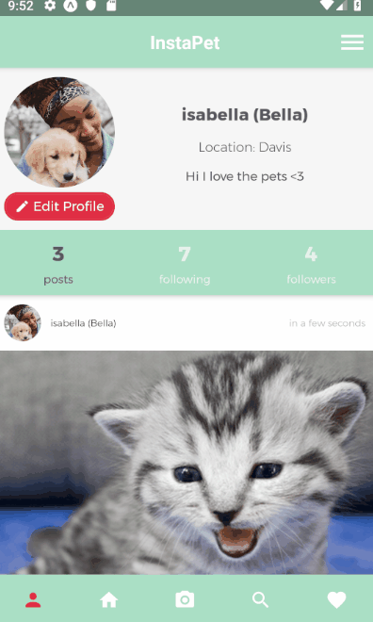
Look back on memories
A collection of your posts can be found on your profile page.

Slide 10
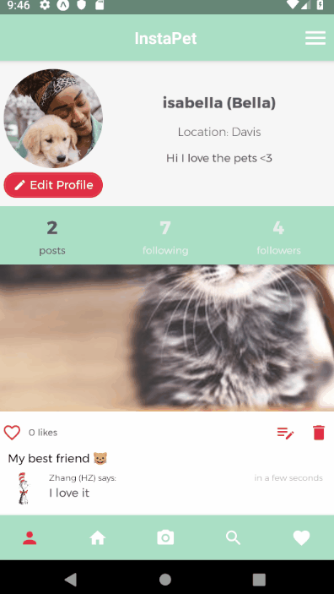
Edit or Delete you posts
Add any information you forgot, or just remove the post from your timeline all together!

Slide 11
S1 - Demo
Demonstrates create, retrieve, edit, and delete post.

Slide 12
Search Feature
Implementing instant search based on usernames to search user profiles.

Slide 13
Full-Text Search:
Cloud Firestore doesn't support native indexing or search for text fields in documents. Solution: Cloud Functions + Algolia.
Cloud Function “listens” to users being updated, created and deleted. Sends event to Algolia for indexing.
Searchable attributes: username, name and lastly city. Clicking on an user tile will send you to their profile.

Slide 14
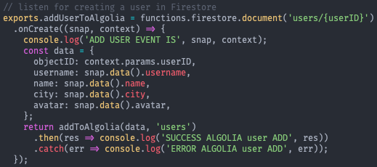
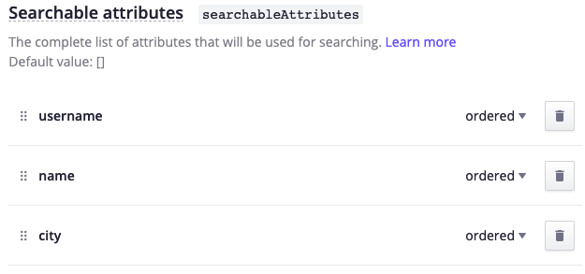
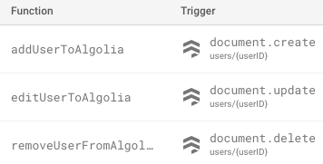
Example Query: Using Algolia
Cloud Function index.js:
Algolia console:
Firestore console:
Firestore logs on the console:

Slide 15
S2 - Demo
Demonstrates searching for users, following & unfollowing them, profile view, etc.

Slide 16
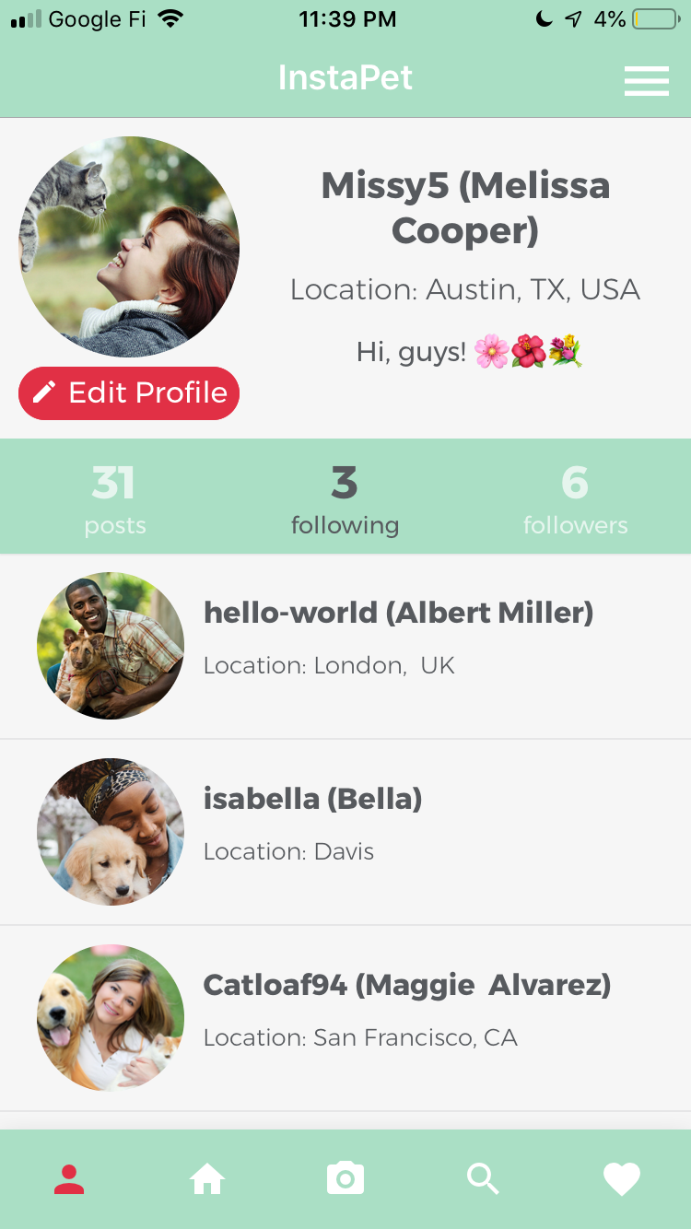
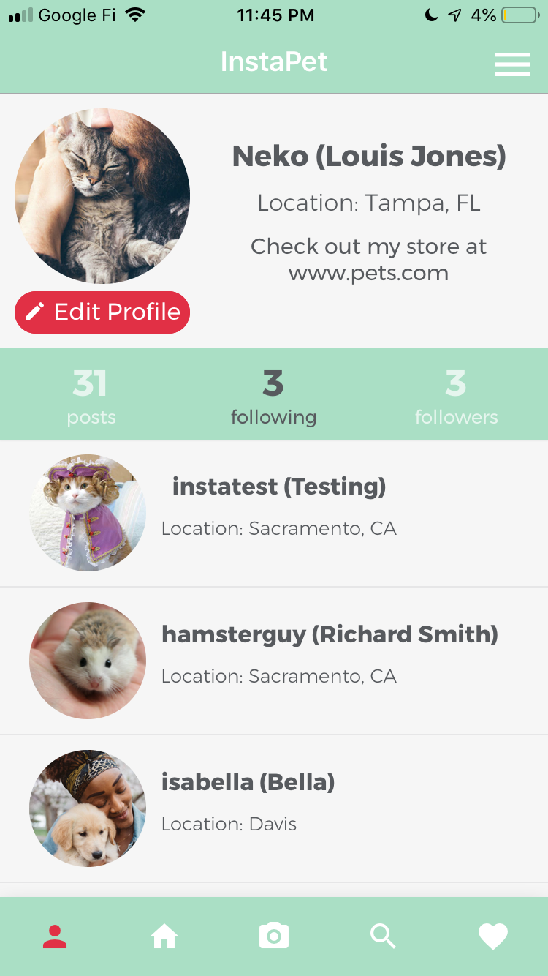
Follow & Unfollow
Melissa searches for Louis and follows him.
Louis sees Melissa in his “followers” tab and follows her. She then shows up on his “following” tab.
Place your screenshot here
Place your screenshot here

Slide 17
Activity Feed
Developing an algorithm to retrieve and maintain up-to-date information from the database.

Slide 18
Algorithm based on post’s timestamp.
Currently used in the App
Display all posts from friends the app user follows sorted by the order they were created.

Slide 19
Algorithms based on time stamp - sample queries
On user profile screen (show app user’s posts history):
this.feedRef = db.collection('posts')
.orderBy('timestamp', 'desc').where('userID', '==', this.userID);
On feed screen (show posts from the people the app user follows by timeline):
this.feedRef = db.collection('posts').orderBy('timestamp', 'desc')
.where('followerIDs', 'array-contains', appUser);

Slide 20
2. Variation: Show most recent K posts from friends sorted by timestamp.
Implemented, but not used in App right now.
Motivation: if a user has not logged in for a long time, we want to provide an overview of what the user’s friends has posted recently.
Can also select most liked/commented K posts from each friend for the feeds of infrequent users to provide them the most exciting stories (instead of newest stories).

Slide 21
S3 - Demo
Demonstrates viewing Activity feed, commenting, and liking posts.

Slide 22
Credits
Presentation template by SlidesCarnival
Algolia tutorial for Cloud Firestore here.
Icons from https://materialdesignicons.com/

Slide 23
Questions?
Thanks

