Slide 1
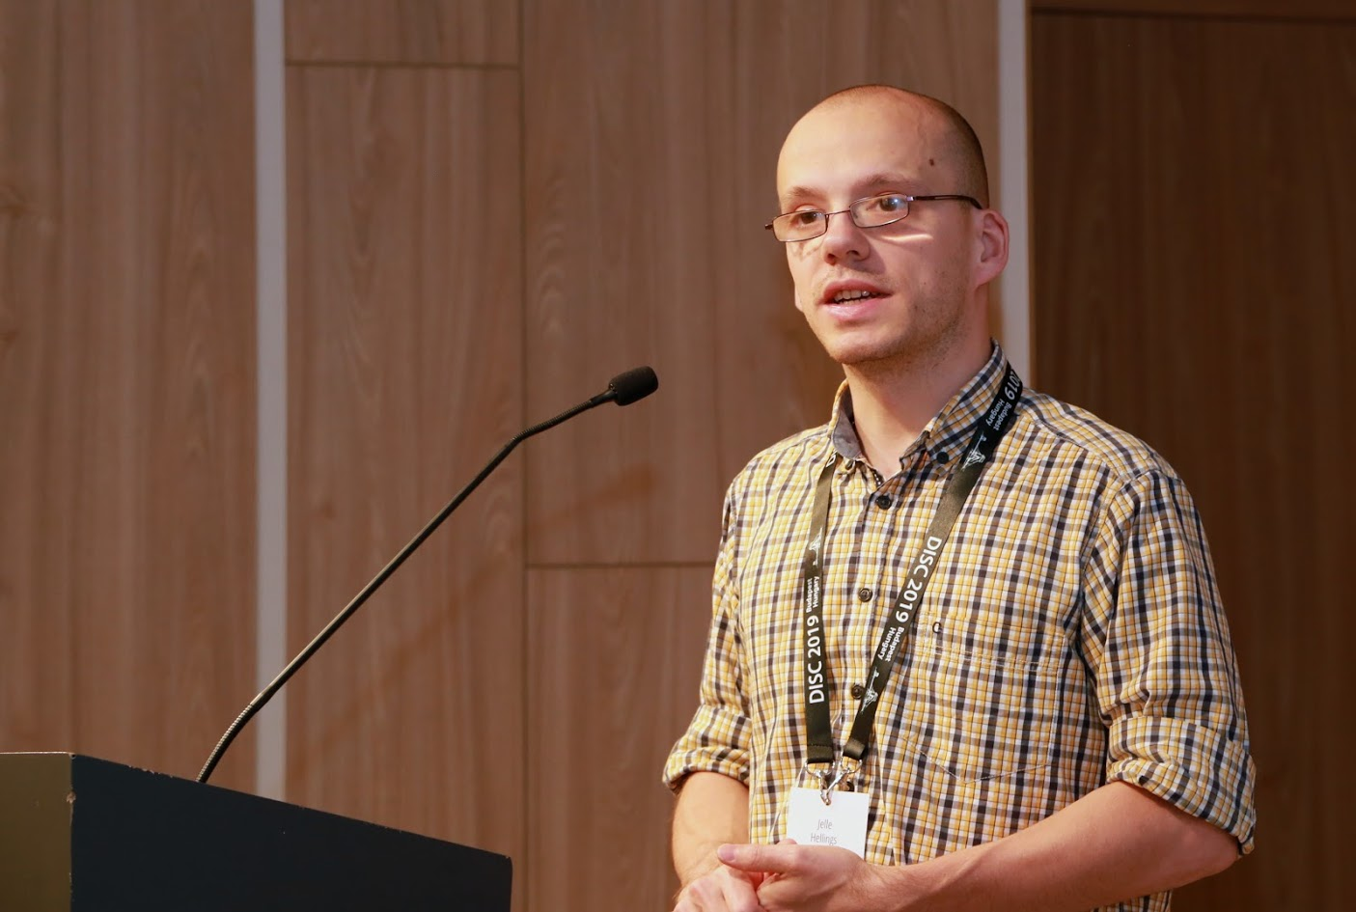
RCC: Resilient Concurrent Consensus for High-Throughput Secure Transaction Processing
Suyash Gupta
Jelle Hellings
Mohammad Sadoghi
MokaBlox LLC
Exploratory Systems Lab
University of California Davis

Slide 2
Secure Decentralized & Democratic System
Alice
Bob

Slide 3
Decentralized System
Replicas
Alice
Bob

Slide 4
Democracy
Right to Vote

Slide 5
Blockchain Technology

Slide 6
What is Blockchain?
New
Block
Previous
Hash
Genesis
Previous
Hash
Previous
Hash
Data
Data
Data
Client Transactions
Linked List of Blocks
Hash of Previous Block

Slide 7
Blockchain Applications
Cryptocurrencies
Project Tracking
Waste
Management
Energy Trading
and Management
Healthcare

Slide 8
At the core of any Blockchain application is a Byzantine Fault-Tolerant (BFT) consensus protocol.
OK
OK
Order Txn
OK

Slide 9
First practical BFT implementation.
Practical Byzantine Fault Tolerance (PBFT)
Client
T
Primary
Replica 1
Replica 2
Byzantine
Client
Request
Pre-Prepare
O(n)
Prepare
O(n²)
Commit
O(n²)
Reply
Execute
Consensus among n replicas & at most f byzantine → n >= 3f+1
n = 4 replicas and f <= 1

Slide 10
What Limits Current Systems? Primary-Backup Paradigm
OK
OK
Replace Primary
System Halts
Order Txn
Primary
OK
Fall in throughput!
Primary

Slide 11
Our Proposal
Democracy → Give all the replicas the power to be the primary.
Parallelism → Run multiple parallel instances of a BFT protocol.
Decentralization → Always there will be a set of ordered client requests.
Resilient Concurrent Consensus

Slide 12
RCC Paradigm
Parallelism
Ordering
Execution
BFT protocol
Run z parallel BFT
instances.
Create a global order
of all the requests.
Execute the requests
in a global order.
Number of
Instances (z)

Slide 13
Client
T
1
Primary
Replica
2
1
Replica
2
Client
T
Primary
Replica
1
2
Byzantine
Replica
1
2
Request
Pre-Prepare
Prepare
Commit
Reply
RCC using PBFT with 2 parallel instances.

Slide 14
Challenges?
How to securely order the requests?
Does failure of one instance causes other instances to stop?
Can there be continuous ordering of requests?
How to fend against coordinated attacks?

Slide 15
Secure Ordering
transfer(A,B,m) → if
bal(A) > m
then
bal(A) = bal(A) – m;
bal(B) = bal(B) + m;
Benefit to Bob!
T1: transfer(Alice, Bob, 2)
T2: transfer(Bob, Eve, 1)
Alice
Bob
Eve
3
1
5
0
5
2
0
3
0
2
0
1
Case 1: T1 then T2
Case 2: T2 then T1

Slide 16
Malicious Primaries Collusion
Good Replicas
|A| = f
Good Replica
|C| = 1
Good Replicas
|B| = f
T₁
T₁
T₂
T₂
T₁
T₂
P₁
|M| = f
Liveness in Danger!
P₂
Other f-2
Malicious Replicas

Slide 17
Magical Ingredient → Good Instances are always Live
Failed instances are stopped and not replaced through independent consensus.
Failed instances can be restarted in future.
Failed instances are stopped and not replaced through independent consensus.
Failed instances can be restarted in future.
Collusion attacks detected when f+1 blame multiple primaries.
Lightweight checkpoints ensure progress.

Slide 18
ResilientDB: High Throughput Yielding, Scalable Permissioned Blockchain Fabric*
Visit at: https://resilientdb.com/
*Proceedings of the 40th IEEE ICDCS 2020.

Slide 19
ResilientDB Architecture
SECURE
LAYER
EXECUTION LAYER
THREADS
SIGNING
TOOLKIT
QUEUES
NET WORK
HASHING
TOOLKIT
BFT CONSENSUS
STORAGE LAYER
METADATA
BLOCKCHAIN

Slide 20
Implementation on ResilientDB
Network
Network
REPLICA
Client
Requests
Batching
Input
Output
Message from
Clients and Replicas
Message to
Replicas or Clients
Execute
Worker
Prepare & Commit
messages
ResilientDB associates a multi-threaded deep-pipelined architecture with each replica.

Slide 21
Evaluating RCC on ResilientDB

Slide 22
Evaluation Metrics
Google cloud used for deploying replicas and clients.
Each replica used 16-core Intel Xeon Cascade Lake CPUs and had access to 32 GB memory.
Total 320K clients deployed on 16 machines.
Workload provided by Yahoo Cloud Serving Benchmark (YCSB).
Experiments ran for 180s → First 60s warmup.

Slide 23
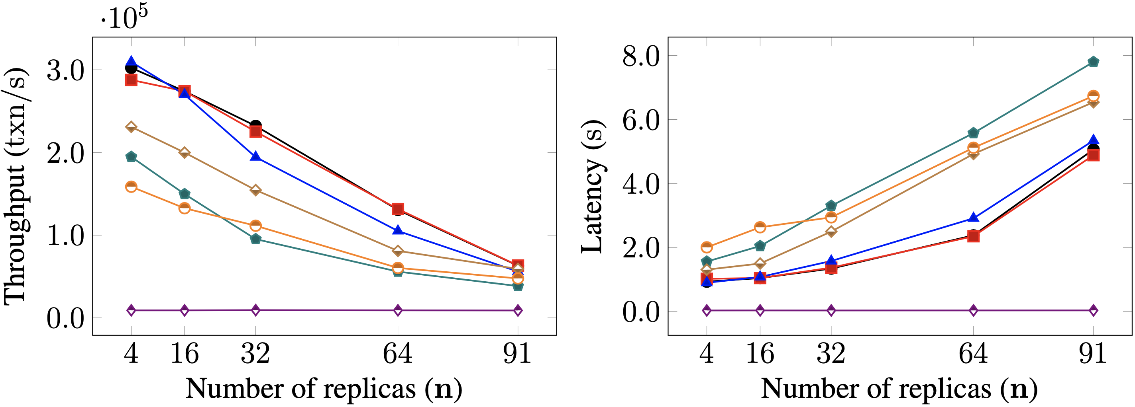
Scalability

Slide 24
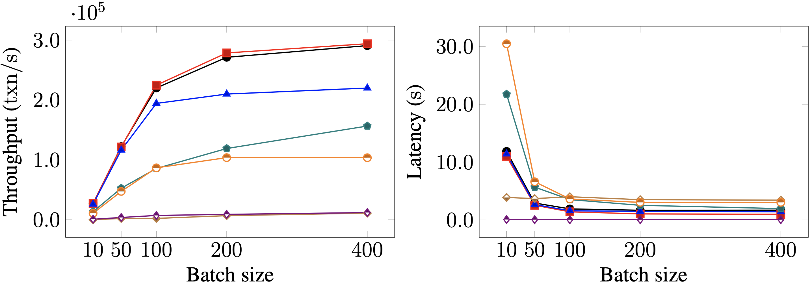
Batching

Slide 25
Conclusions and Final Remarks
RCC is a meta-BFT protocol that delegates power to each replica.
RCC allows all “n” replicas to be primary → parallel consensus
RCC guarantees that there will be always a set of ordered client requests.
RCC provides solution to handle collusion attacks.
RCC facilitates secure ordering of requests.

Slide 26
Thank You

